Slide 1
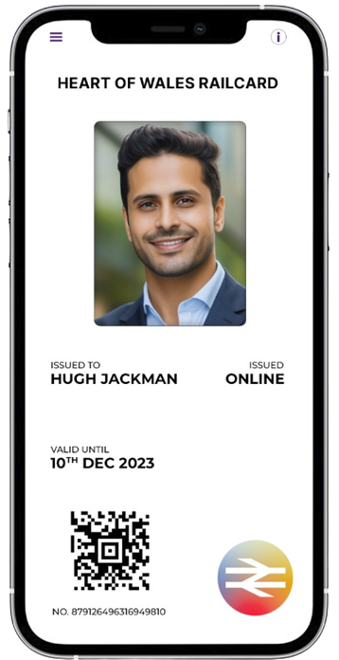




JurnyOn
Worlds 1st Blockchain based Railcard & Train Ticketing App
RAJ GOKAL
ONLINE

Slide 2





The Problem…
£240 million
3.2 million
lost across UK in revenue due to ticketing & rail card fraud
of the Welsh population do not have access to Digital Rail Cards.
91%
140,000
of people give an excuse of not being able to scan tickets at the station gates
students across 10 universities do not have access to digitized Welsh Student Discount Rail Cards

Slide 3
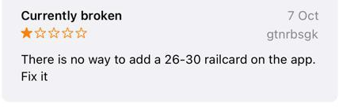




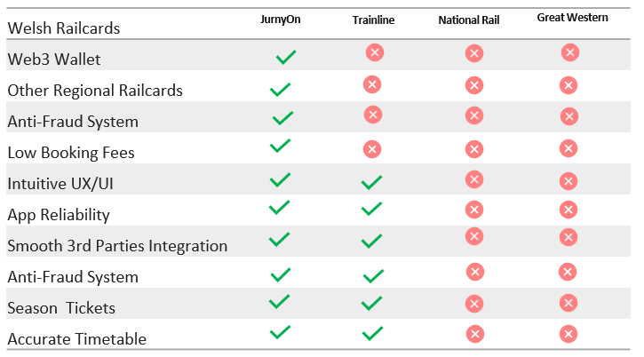
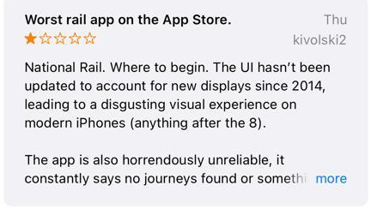
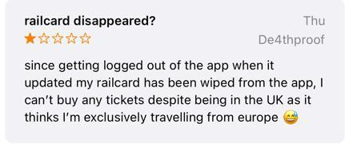
Existing Players Solving it but Poorly…

Slide 4
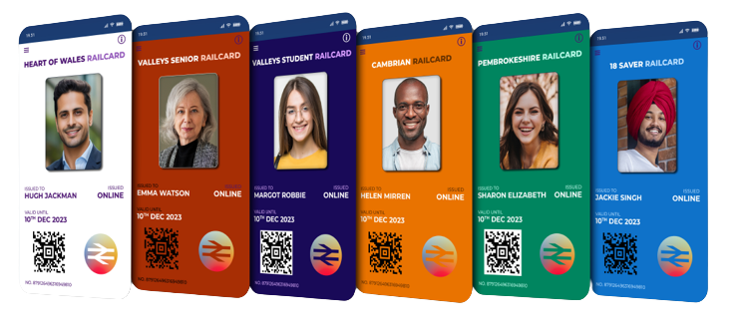
The Solution…
We have partnered with the Welsh Government to digitize Railcards for their citizens, bringing transparency with Solana blockchain & combating fraud with cryptographic wallet all while enhancing the travel experience with conversational AI.

Slide 5

Product Demo Video…
JurnyOn Product Demo: Elevate Your Rail Travel
Witness the future of rail travel with JurnyOn.
Experience the convenience, security, & seamless experience that sets us apart.
Explore our user-friendly app, discover the power of blockchain security, & reimagine rail cards & ticketing. Get ready to revolutionize your travel experience with JurnyOn!

Slide 6
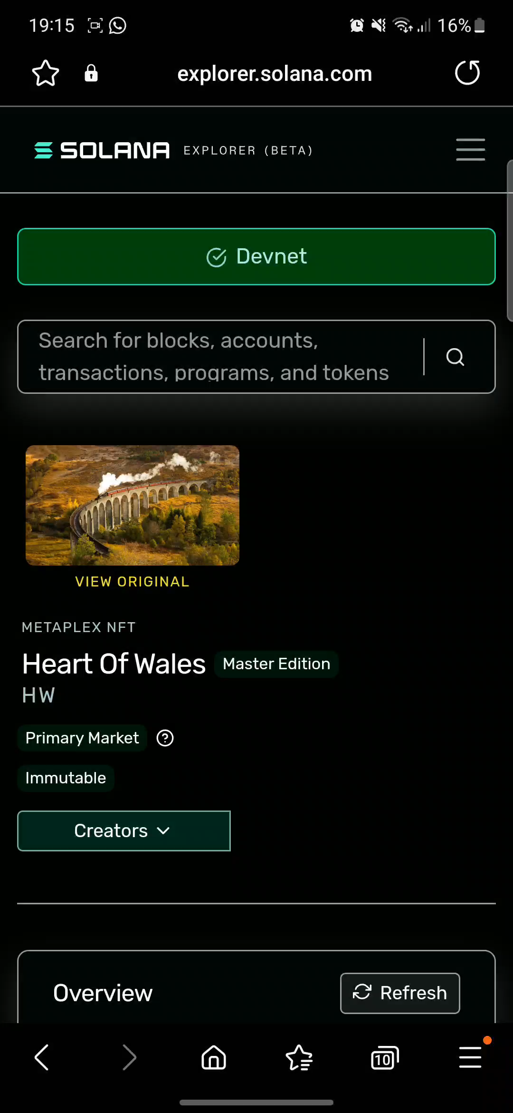
RailCard On Chain

Slide 8
Making It Happen...
Current Future
Near Future
Distant Future
RailCards sales (UK)
Season Ticket sales (UK)
Expand Into Europe
Solana Blockchain
Bus Ticket sales (UK)
Subscription Model
Web3 Wallet
Loyalty Program
API Model
Train Ticket sales (UK)

Slide 9







Faring Well Up to Now…
Partnering with Transport for Wales to build the worlds 1st Train Ticketing app on the Blockchain
Partnership with Yale Smart Lock System to build the world’s 1st Property Management Digital Web3 wallet.
Paid pilot for Property Management Digital Wallets with Tricon Residential a NYSE listed company who manage 30,000 + homes across USA & Canada
Our tech is going to the Moon on a SpaceX rocket - Nov’2023

Slide 10
Product Market Fit
“Customers have been asking for access to the range of Transport For Wales Railcards to be purchased digitally, JurnyOn have provided this service using technology to make the railcard easy to purchase & present when buying a ticket or being inspected on train, whilst exceeding industry standards for security & fraud prevention. ”

Slide 11
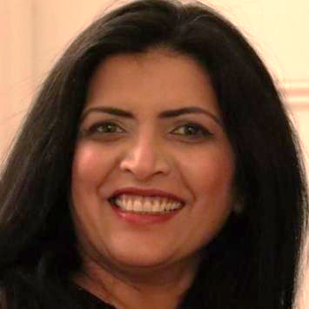









Why Us?
Team
HQNFTs is a multichain no-code infrastructure platform
Commendable Track Record: The team has an impressive track record of consulting with the UK government for more than 5 years.
Pandemic Involvement: Team worked with the UK Government & built models to predicting COVID waves.
Language Model Development (LLM): Team worked with the Government to build LLM to analyse & understand public sentiment during the pandemic
In our past startup, we created an early LLM for SEC & FCA compliance, now used by top hedge funds like Peconic, the world's leading hedge fund.
Divya Prashanth
CEO & Co-Founder |Solidity Developer| Data Scientist |
MERN Dev |Mentor | Speaker | NASDAQ Contributor
Most Influential CEO 2023
Janine Miles MSc.
COO & Co-Founder | Data Scientist | Head Ops @ Eaton Aerospace
|
|
Scott Page
Advisor | Web3 Evangelist | 2 time exit Founder
Saxophonist
Ian Utile
Advisor | Chief of Staff Hadera Hashgraph | Co-Producer NFT.NYC

Slide 12
Market Size - Opportunity
£150.3B
£2.3B
£100M
Overall, Global Train
Ticketing Opportunity
Overall, UK Train
Ticketing Opportunity
10% of Rail Ticket Opportunity in UK
Total
Addressable Market
Serviceable
Addressable Market
Serviceable
Obtainable Market

Slide 13
Contact Details
www.hqnfts.xyz
Telegram: @hqnfts
Twitter: @hqnfts
Email: janine@hqnfts.xyz divya@hqnfts.xyz

